Slide 1
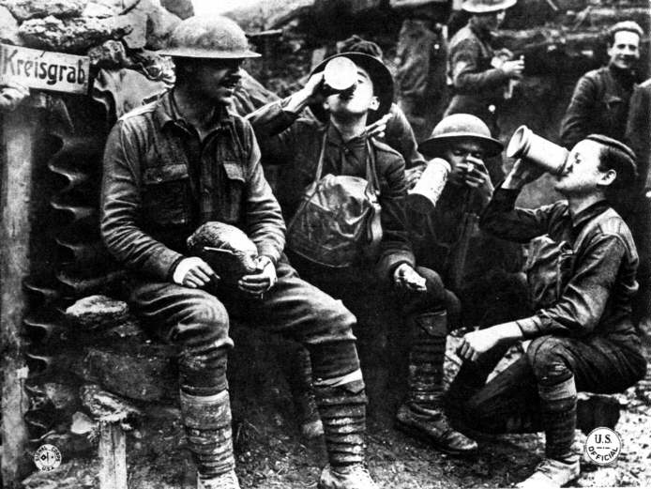
Pictured here are soldiers sharing a drink and a laugh in the dug out.

Slide 2
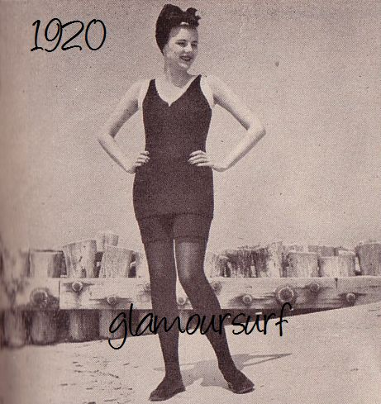
Pictured here is young woman at the beach wearing the normal swim attire.

Slide 3
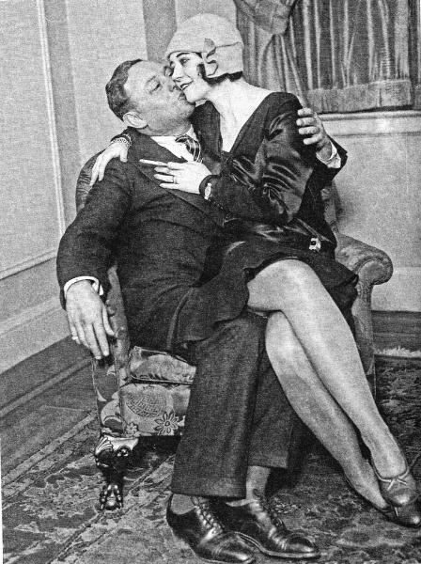
A flapper girl and one her many aqaintences.

Slide 4
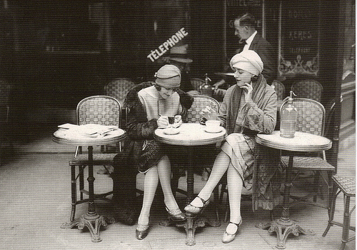
Two flapper girls sharing a smoke.

Slide 5
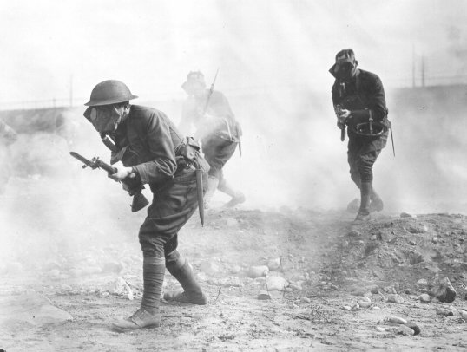
Behind enemy lines.

Slide 6
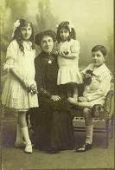
Typical family of 1920’s

Slide 7
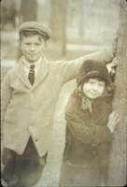

Slide 8
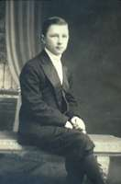

Slide 9
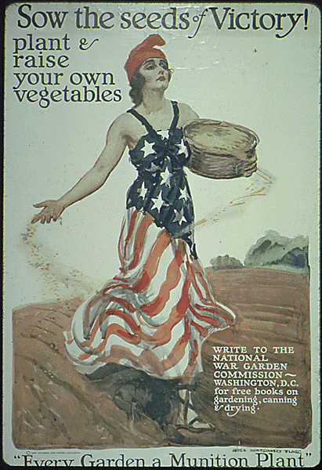

Slide 10
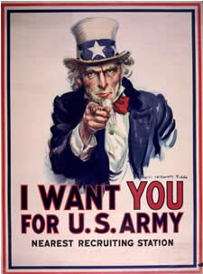

Slide 11
